Slide 1


Rocket NLP: Rapid End to End NLP Development and Analysis
Ryan Cornea, Thomas Ginter, Scott DuVall

Slide 2

UIMA
Reusable logic modules (Annotation Engine or AE)
Easily convert modules to UIMA Annotation Engine
Form organized pipelines of modules (Aggregate AE)
Common infrastructure
Serialization and Transport of Data
Metadata Storage and Indexing
Community support
Asynchronous Scale Out (UIMA-AS)
Notes:
Evaluated various platforms, including the possibility of writing our own, and eventually chose UIMA.
Benefits from our point of view

Slide 3
Core UIMA
Pipeline
CAS
Collection
Reader
Tokenizer
Sentence Detection
Chunker
NER
Listener

Slide 4
UIMA-AS
Top Aggregate
Descriptor
UIMA AS Service
Deployment
Descriptor
AE
JMX
Input Queue
Asynchronous
Messaging
Reply Queue
CAS
Collection
Reader
UIMA AS Client
Listener
UIMA AS Client
Notes:
UIMA-AS utilizes an open source JMS queueing application to coordinate messages between one or more services and one or more client applications.
Service and client can be co-located
Services across machines, same jvm, multiple jvms, etc. Multiple clients accessing one family of services including services that remotely access other deployed services.

Slide 5
Goal
Rapid NLP Development
Scalable Architecture
Analysis code reuse – ours and theirs

Slide 6

Leo

Slide 7
Leo Framework Feature
Leo Aggregate Engine
Leo
Deployment
Descriptor
Token
Annotator
Sentence
Annotator
Chunker
Annotator
Regex
Annotator
Dictionary
Annotator
Leo Service
UIMA AS Service
Deployment
Descriptor
Top Aggregate
Descriptor
AE
JMX
Input Queue
Asynchronous
Messaging
Reply Queue
SubReader
UIMA AS Client
UIMA AS Client
Leo
SuperReader*
Listener(s)
Leo Client
*Can also use Standard UIMA CollectionReader

Slide 8
Leo Framework Feature
Programmatically Generate:
UIMA Descriptors
Parameter and Type information for AE
Aggregate AE for a Service
Deployment Configuration
Standard and Custom CollectionReaders
Standard and Custom Listeners
Launch Services and Clients in UIMA-AS

Slide 9
Leo Service Overview
Define Pipeline Programmatically
(Type System, Annotators)
Register with Analytics Module (optional)
Deploy
(Generates UIMA XML files, deploys to UIMA AS Broker)

Slide 10
Leo Client Overview
Define Client
(Broker URL and Service Name, Collection Reader, Listeners)
Run
(Standard UIMA AS send CAS and invoke Listeners on results)

Slide 11
Leo Readers
File
XMI
Simple Database
Batched Database
Knowtator
Siman
Third Party/Custom Readers

Slide 12
Leo Listeners
CSV
XMI
Database
Siman
Knowtator
Third Party Listeners

Slide 13
Leo Annotation Feature
Annotation Utilities
Find, compare, overlap, modify…
Annotator Functionality
Base structure for standard module implementation

Slide 14

Current Release 2013.11.1

Slide 15
Leo’s Universe
Project AEs
- Applied project AEs
- Not-quite Enterprise AEs
Chex
- Validation
JAM
- Performance monitoring
AnnotationLibrarian
& Enterprise Quality AEs
Sherlock
- Machine Learning Framework
Siman
- Simple Annotation Schema
Any UIMA AS AEs
Leo-Base
- Leo-Client
- Leo-Service
eHOST
- Annotation and document classification
Any (non-AS) UIMA AEs
like cTAKES
UIMA AS
Notes:
Set of libraries that provides easy access to UIMA AS functionality.
BONES: ws annotator, regex, annotation pattern
DERMA: hist, window annotator
PROJECTS: smoking, bcc, cvad, etc
Marian
ALSO ADD other UIMA annotators (Leo can register automatically)

Slide 16
JMX Monitoring
JMX Monitoring provides the missing piece to UIMA AS:
Easy collection of performance metrics for running UIMA pipelines
Aggregation of statistics from a distributed system
Presentation of statistics in an easy to interpret format

Slide 17
Analytics Tool
Design Goals
Gather statistics from various UIMA AS services
Aggregate the data into meaningful numbers
Give a both a broad and detailed view of system performance
Easy to use
Persist analytics
Compare analytics over time [Future work]
Allocate new resources as bottlenecks occur. [Future work]

Slide 18

JAM

Slide 19
JAM
JMX: Port
UIMA AS
Server 1
JAM Server
Statistics:
Aggregate
Individual
Real Time Gathering
Can Gather Over a Port Range
Compare Over Time (Future)
Standard WAR (Tomcat, Jetty, JBOSS, etc.)
Web User Interface
Service 1
Performance Metrics
DB
UIMA AS
Server 2
JMX: Port 1
Service 1
JMX: Port 2
Service 2

Slide 20
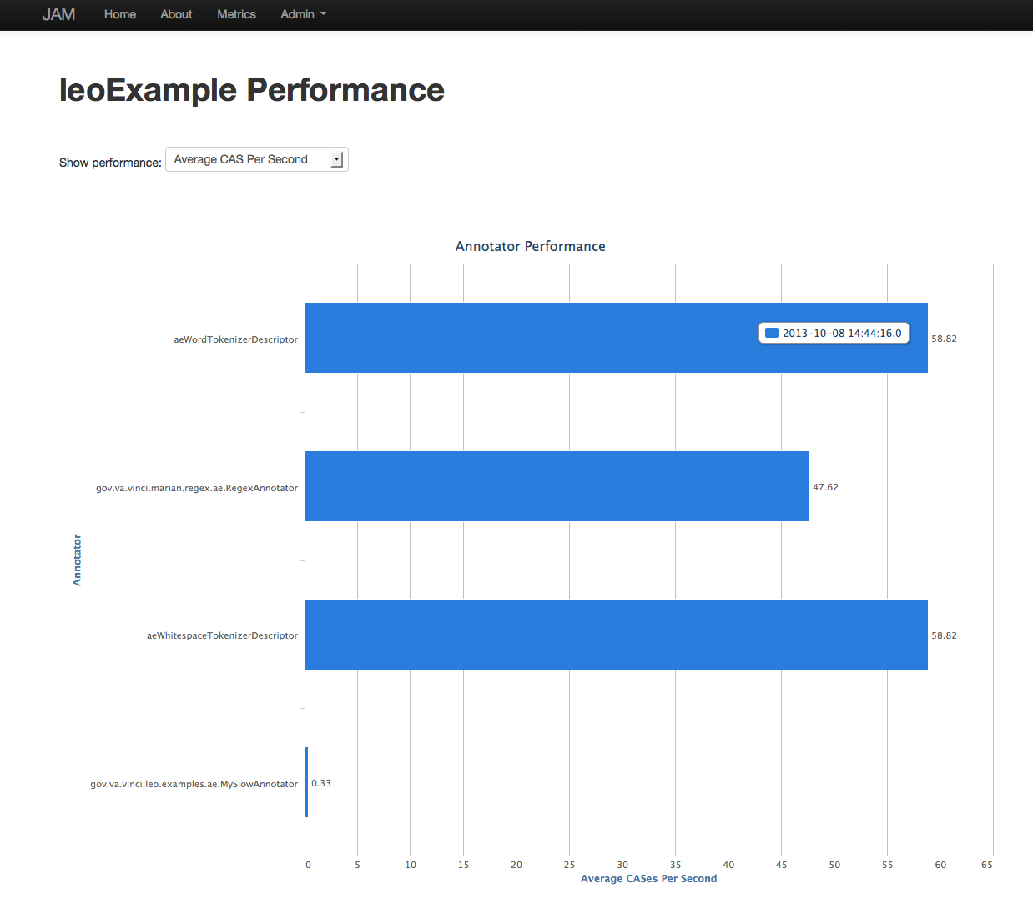
Service View

Slide 21
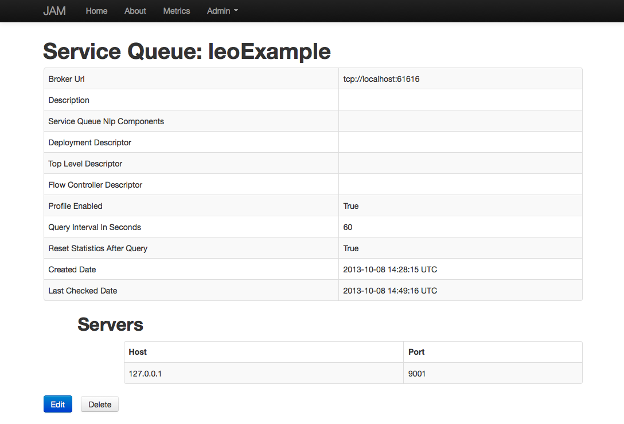
Service Details Screen

Slide 22
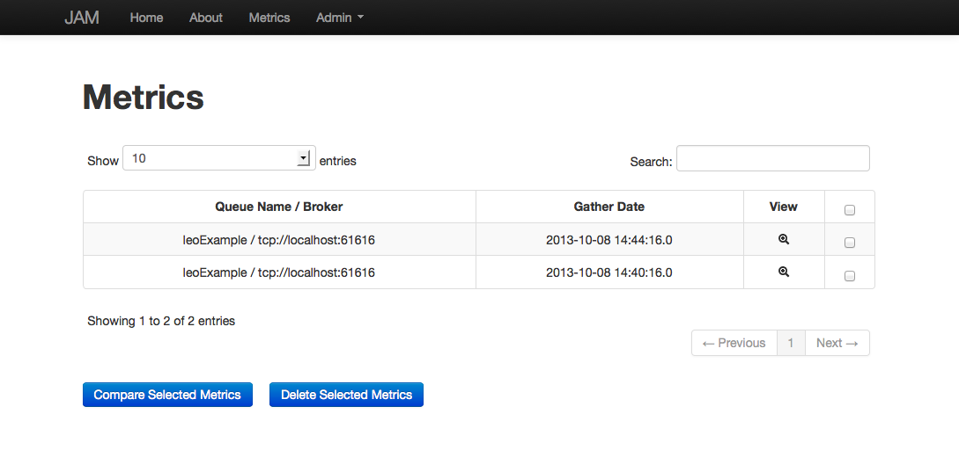
Metrics

Slide 23
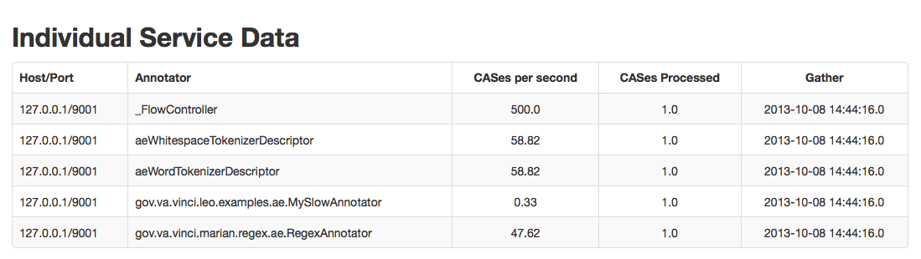
Service View Details

Slide 24
Chex Validation and Classification Made Easy

Slide 25
Chex
Chex is a web application that allows for annotators to validate information.
Information is stored in the SIMAN format.
Reporting on validation status is built it.
Reads from project specific databases, not one single unified database.
Supports all major databases
Validation information can be read from SIMAN and added into a UIMA pipeline.

Slide 26
Validation Tasks

Slide 27
Instance View

Slide 28
Document View

Slide 29
Review

Slide 30
Reports

Slide 31
Corpus Summary

Slide 32
Validation Summary

Slide 33

Sherlock

Slide 34
Machine Learning
Many different ML frameworks available
MALLET, R, Weka…
Every framework has a different
Data Model
API
Framework differences complicate reuse, flexibility and inhibit rapid development

Slide 35
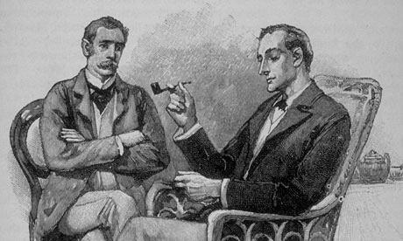
Sherlock
ML Framework Agnostic
Reusable modules
Feature Vectors
Prediction
Training
Easy Integration with UIMA-AS/Leo

Slide 36

Sherlock’s Tool Arsenal
SherlockTrainer
Train, Test, and Cross Validate
Requires VectorTranslator and List of FeatureVectors
PredictionMap
Maps input from human classified data to ML labels
Uses JSON formatted string to define mapping
SherlockVector
Stores a prediction string, keys, and values for a specific feature vector

Slide 37
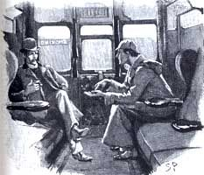
Sherlock In Action
Training Pipeline
MyFeatureVector extends BaseFeatureVectorAnnotator
MyLearningListener
extends
Learning Listener
SherlockTrainer
MALLET, R, Weka…
VectorTranslator*
*ML Framework Specific
Prediction Pipeline
MyFeatureVector extends BaseFeatureVectorAnnotator
LearningAnnotator

